Slide 1

NYC 2015 Street Tree Census
Professor: Mykhaylo Trubskyy
Xiao Bao
Chong fan Bao
Wang Zheng
Haonan Hu
Group 1
Date: 05/17/2021

Slide 2

01.
What is the trunk diameter of tree in different situations and conditions
02.
Business
Question
Tree species and the geolocation map of the diameter of tree trunk
03.
How different problems influence the average diameter of tree
04.
The status and health of tree under gaurd and sidewalk damage by trees

Slide 3

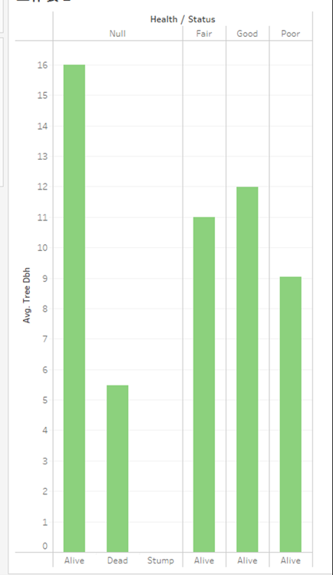
What is the trunk diameter of tree in different situations and conditions?
1. The tree with a larger diameter has a better health situation than the tree with a smaller diameter.
2. The alive tree's diameter is significantly larger than the dead tree's diameter.
Inference: A larger trunk diameter in a tree means a better health situation and higher survival rate than a tree with smaller trunk diameter.
Suggestion: To increase the tree's survival rate and its healthy condition, we can focus on finding ways to increases the trunk diameter.

Slide 4
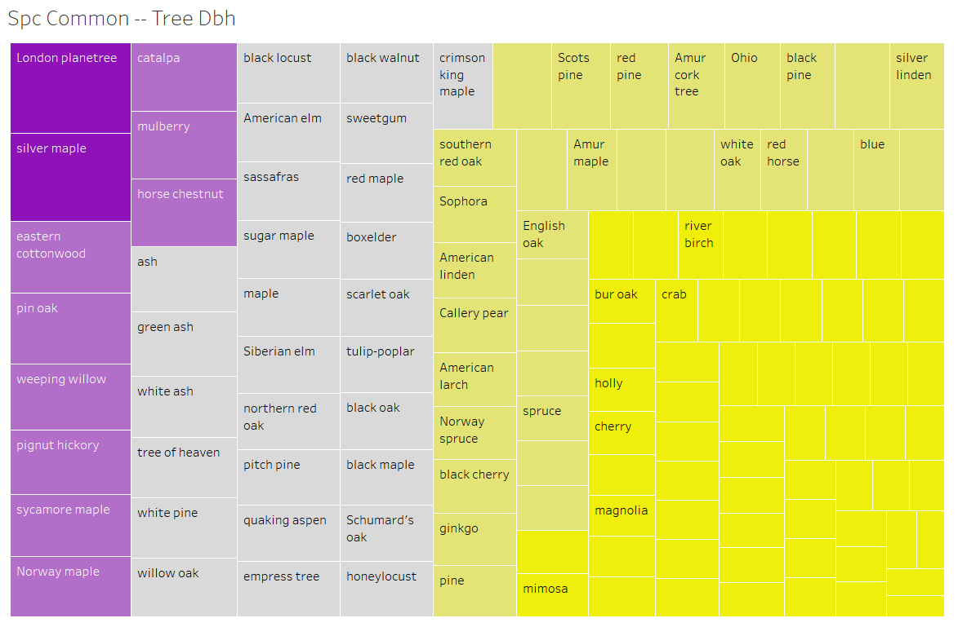
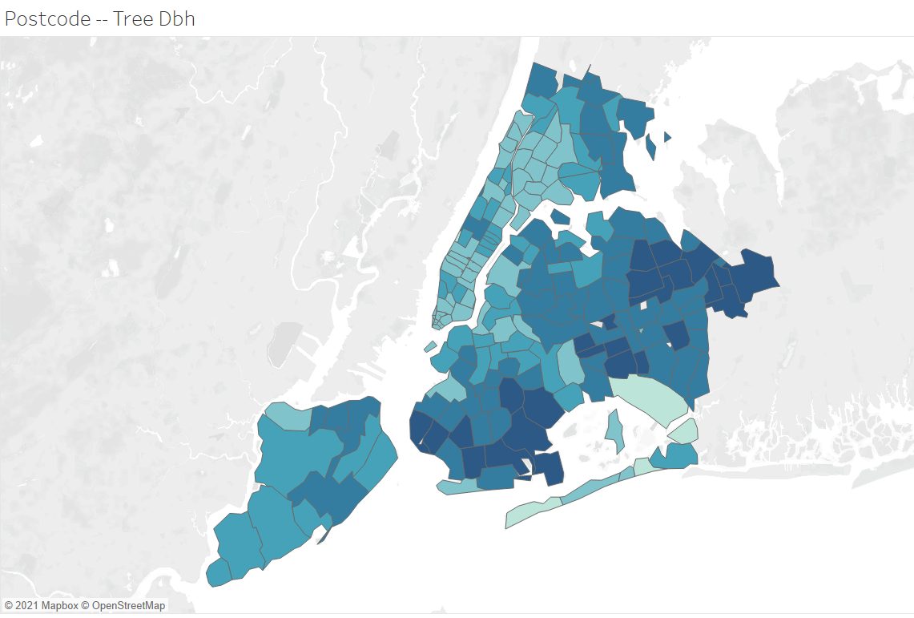
Tree species and the geolocation map of the diameter of tree trunk
1. The three tree species with the largest tree trunk diameter are London Planetree, Silver Maple, Eastern Cottonwood, etc.
2. In the areas where the zip code is 11040, 11223, 11234, and 11364, the tree trunk diameter is the largest.
Suggestion: If you want to transplant trees, you can pick them from these zip codes because those places have the largest width of the tree

Slide 5
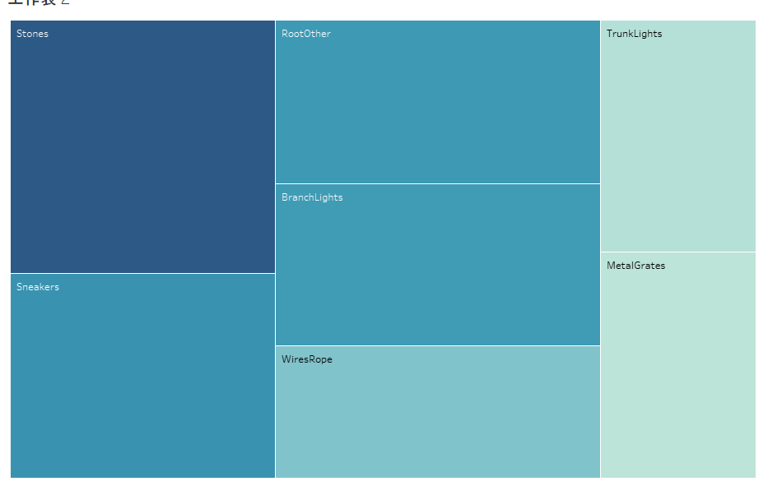
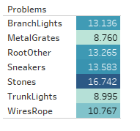
How different problems influence the average diameter of tree?
1. Stones this problem seems not to influence tree’s diameter because the tree with the stone problem has a 16.74 average diameter.
2. The tree with the good condition have 12 average diameter.
3. The poor tree has a 9-average diameter
Inference: Those two problems are harmful to the tree’s diameter; it causes the tree to have a lighter diameter.
Suggestion: we must be careful about the problems of metal grates; it can significantly hider tree's width size. I suggest the related department arrange the metal grates away from trees.

Slide 6
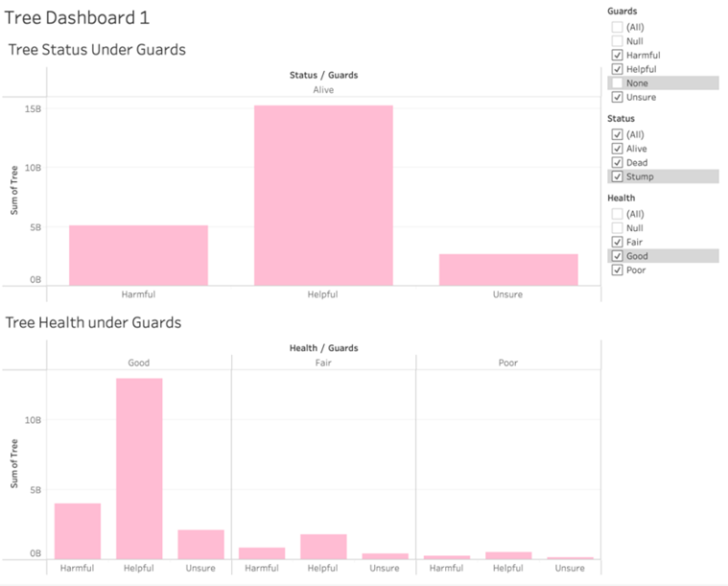
The status and health of tree under gaurd
The existence of the gardener is very helpful to the survival of the tree, but at the same time it can also cause death to the tree. And there are still many trees that cause death due to human factors.
Suggestion: Carry out the cultivation of standardized gardener skills and reduce the cause of man-made. Investigate uncertain factors to avoid uncertainties and potential problems.

Slide 7
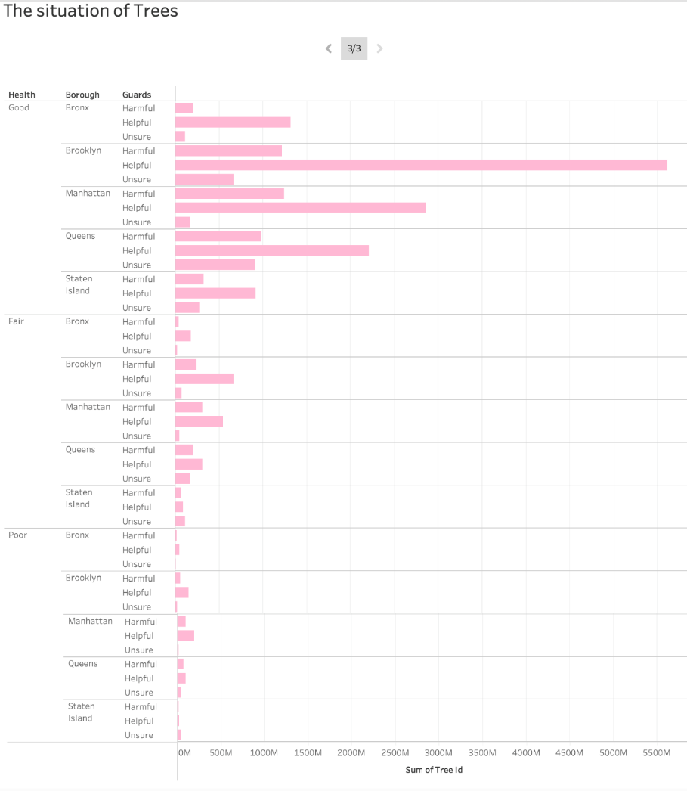
Under the supervision of gardeners, Brooklyn is the area with the best tree health, and Staten Island is the worst. Additionally, Manhattan has the largest number of poor healthy tree.
Suggestion: Carry out the monitoring of the trees to see why there are still many causes of death under the care of the trees. If necessary, install the corresponding monitoring to see if it is deliberately damaged

Slide 8
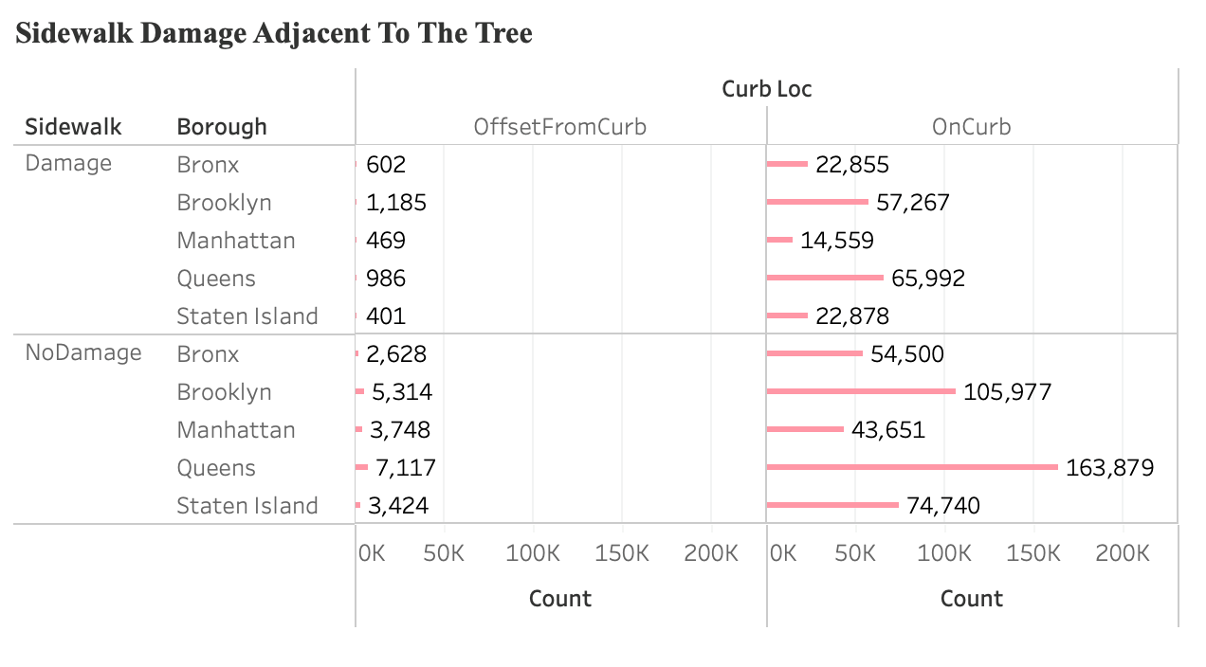
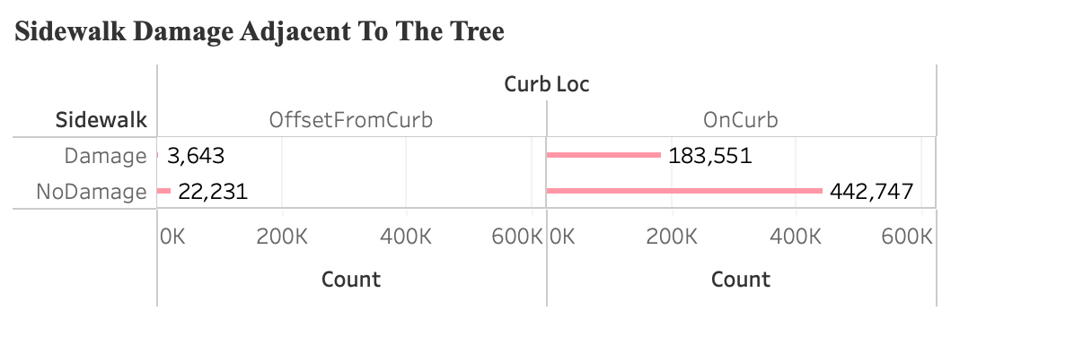
Sidewalk Damage
1.Some trees adjacent to curb damage the road, which could bring unnecessary troubles to repair the road and increase the maintenance cost
2.Brooklyn and Queens are the top two districts.
Sugesstion: It is necessary to conduct a detailed investigation of what contributed to the road damage.

Slide 9
Thank YOU
Date: 05/17/2021

